Slide 1


Introducing TCM
The NonStop Service Experts
Confidential. Copyright TCM Solutions Ltd 2023.

Slide 2

Introducing TCM
Who We Are
What We Do
Key Service Offerings
  Systems Management, Administration, Operations
  Migration Services
  Data Replication
  Projects and Specialist Consultancy
The Future
Confidential. Copyright TCM Solutions Ltd 2023.
www.tcm.co.uk
+44 (0)1592 770081

Slide 3


TCM
Dedicated NonStop service experts since ‘96
Designing and delivering service solutions to NonStop Customers around the globe
Onsite and Remote services delivered via Centre of Excellence based in Scotland
Never lost a Customer, never failed an SLA
Flexible, responsive, adaptable, trusted partner
Preserving NonStop knowledge
HPE Silver Partner
Who We Are
Confidential. Copyright TCM Solutions Ltd 2023.
www.tcm.co.uk
+44 (0)1592 770081
3

Slide 4

What We Do
We offer a ‘full suite of services’
Can build a service around any NonStop requirement
Bespoke Solutions, tailored to the Customer’s PRECISE needs
Confidential. Copyright TCM Solutions Ltd 2023.
www.tcm.co.uk
+44 (0)1592 770081

Slide 5
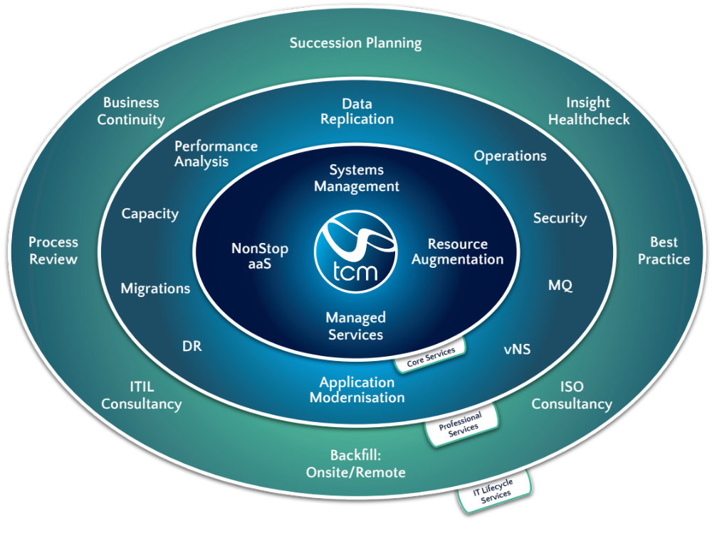
The Full Suite of NonStop Services
Confidential. Copyright TCM Solutions Ltd 2023.
www.tcm.co.uk
+44 (0)1592 770081

Slide 6
Key Services:
NonStop Systems Management – fully managed, outsourced solutions
NonStop Migrations – Systems and Applications
Data Replication Experts – all products
NonStop Projects and Specialist Consultancy
    basically the unusual, difficult things that do not fit neatly into a ‘box’. We excel in this area.
Confidential. Copyright TCM Solutions Ltd 2023.
www.tcm.co.uk
+44 (0)1592 770081

Slide 7
Systems Management
Full responsibility for managing, administration and monitoring of Customer NonStop systems and Application 1st line
End-to-End 24x7x365 support
Dedicated Service Account Manager
Tailored monthly analysis & reporting
Delivered onsite and remotely via TCM Centre of Excellence
Adapted to suit exact needs of Customer
Customer retains control, but removes risk and operational ‘headache’
Wat We Did
Confidential. Copyright TCM Solutions Ltd 2023.
www.tcm.co.uk
+44 (0)1592 770081

Slide 8





What We Did
Confidential. Copyright TCM Solutions Ltd 2023.
www.tcm.co.uk
+44 (0)1592 770081

Slide 9
Migrations – System & Application
Appointed Key Partner by HPE on NSX Migration program – only current EMEA-based partner
NonStop X (latest platform) migration experts
End-to-End management of systems and applications migration
Accredited Project Managers
On hand to ‘fill gaps’ between current and future state, including ‘modernization’
Wat We Did
Confidential. Copyright TCM Solutions Ltd 2023.
www.tcm.co.uk
+44 (0)1592 770081

Slide 10



What We Did
Confidential. Copyright TCM Solutions Ltd 2023.
www.tcm.co.uk
+44 (0)1592 770081

Slide 11
Data Replication
Installation, configuration, migration/switch
RDF, Shadowbase (AutoTMF, AutoSync), DRNet, GoldenGate
Key Partner of Gravic/HPE for Shadowbase
Currently providing Shadowbase installations across EMEA
Presented ‘Shadowbase: A Swiss Army Knife Guide’ at TBC 2018
End-to-End management of project
Filling gaps as required
Wat We Did
Confidential. Copyright TCM Solutions Ltd 2023.
www.tcm.co.uk
+44 (0)1592 770081

Slide 12



What We Did
Confidential. Copyright TCM Solutions Ltd 2023.
www.tcm.co.uk
+44 (0)1592 770081

Slide 13
New Services:
System/Application Modernization
vNS Services
TCM InSight Healthcheck
Confidential. Copyright TCM Solutions Ltd 2023.
www.tcm.co.uk
+44 (0)1592 770081

Slide 14
System/Application Modernisation
TCM are helping companies with legacy/in-house written NonStop applications reach their full potential
TCM Application experts can advise how these applications can easily be enhanced via the use of modern, even open-source technologies
Many do not realize these industry-standard tool and utilities can run natively on NonStop, and are probably found in other parts of the organization
TCM recently developed our own in-house written application utilizing the following technologies:
Wat We Did
Confidential. Copyright TCM Solutions Ltd 2023.
www.tcm.co.uk
+44 (0)1592 770081

Slide 15














What We Did
Confidential. Copyright TCM Solutions Ltd 2023.
www.tcm.co.uk
+44 (0)1592 770081
GNU Autoconf

Slide 16
System/Application Modernisation
By adopting these technologies, the NonStop can be opened-up and more heavily integrated with the rest of the organization’s IT practices
We can even combine their use into a modern framework with NonStop incorporated just as any other platform would be
For example, in DevOps:
Wat We Did
Confidential. Copyright TCM Solutions Ltd 2023.
www.tcm.co.uk
+44 (0)1592 770081

Slide 17
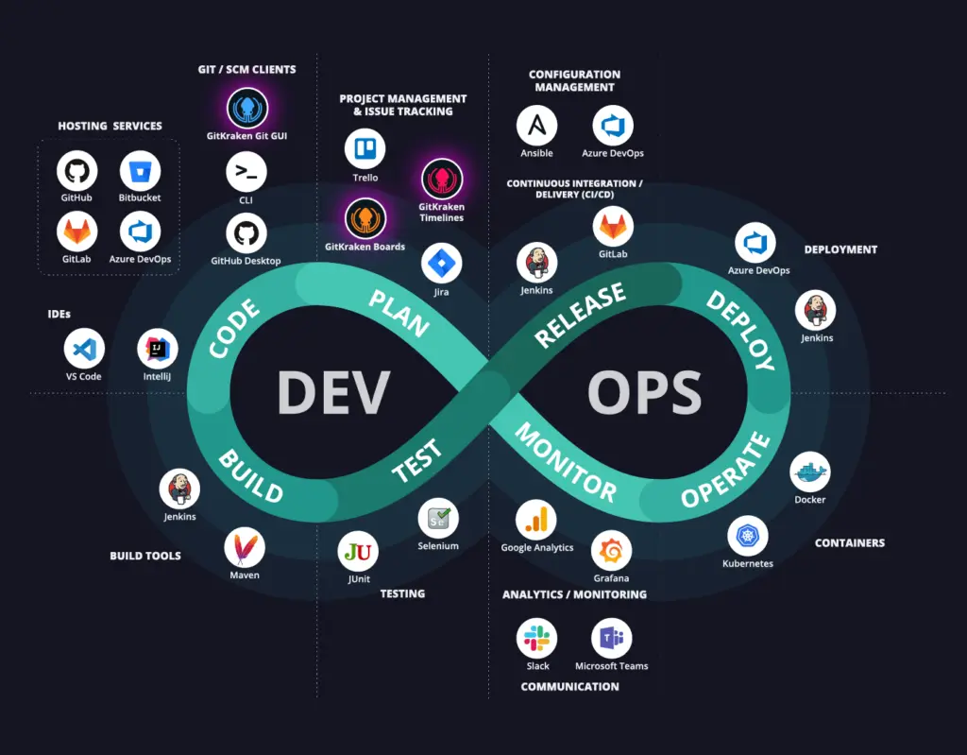





The Infinity Loop
CODE
DEPLOY
PLAN
BUILD
INTEGRATE
OPERATE
Confidential. Copyright TCM Solutions Ltd 2032.
www.tcm.co.uk
+44 (0)1592 770081
TEST
MONITOR

Slide 18
System/Application Modernisation
By adopting these technologies, the NonStop can be opened-up and more heavily integrated with the rest of the organization’s IT practices
We can even combine their use into a modern framework with NonStop incorporated just as any other platform would be
For example, in DevOps:
TCM can consult and assist with not only the adoption of these new technologies, but also your strategy in terms of why you are looking to use them, and what benefits you want to achieve
Wat We Did
Confidential. Copyright TCM Solutions Ltd 2023.
www.tcm.co.uk
+44 (0)1592 770081

Slide 19
vNS Services
TCM is at forefront of vNS technology
Working closely with HPE vNS development team, sharing ideas and assisting in real-world trial of latest developments – Azure, Google cloud etc.
Built and run our own internal vNS machines for testing, training and development
Can assist with technical services around helping to build your own vNS, building one for you, or even operating in As-A-Service
Crucially, TCM can help guide you on your journey to cloud – translating your motivations into simple steps and plans
Wat We Did
Confidential. Copyright TCM Solutions Ltd 2023.
www.tcm.co.uk
+44 (0)1592 770081

Slide 20

INTRODUCING
TCM InSight
What is InSight?
TCM InSight is a quick, snapshot assessment, aimed at providing a clear and accurate understanding of your NonStop systems and setup
Confidential. Copyright TCM Solutions Ltd 2023.
www.tcm.co.uk
+44 (0)1592 770081

Slide 21


INTRODUCING
TCM InSight
What is InSight?
In essence, a short yet comprehensive audit
Lasting only a few days
With minimal input from Customer
Designed, built and delivered in collaboration with HPE
Confidential. Copyright TCM Solutions Ltd 2023.
www.tcm.co.uk
+44 (0)1592 770081

Slide 22
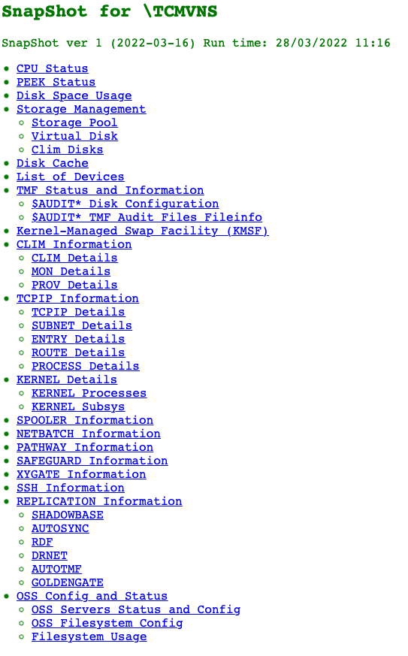
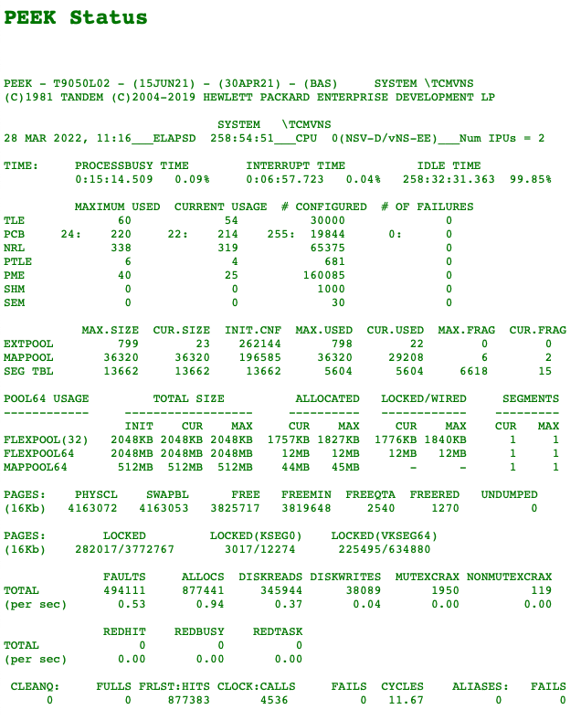
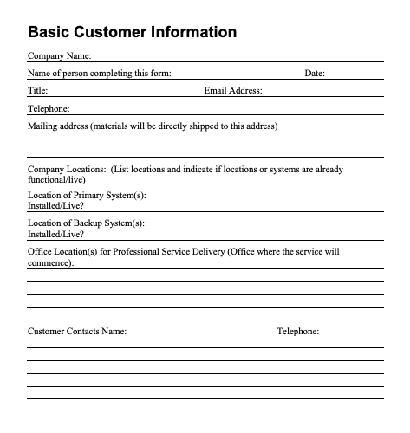

HOW IT WORKS
GATHER DATA
  Short questionnaire filled out by customer
  Simple ‘press of a button’ script run by customer will produce majority of data accessed by TCM via secure HTML file
  Follow-up questions for context/understanding via email or video call
ANALYSE DATA
  TCM Experts across all fields of NonStop will review data and compare with best practice
HOW IT WORKS
Confidential. Copyright TCM Solutions Ltd 2023.
www.tcm.co.uk
+44 (0)1592 770081

Slide 23
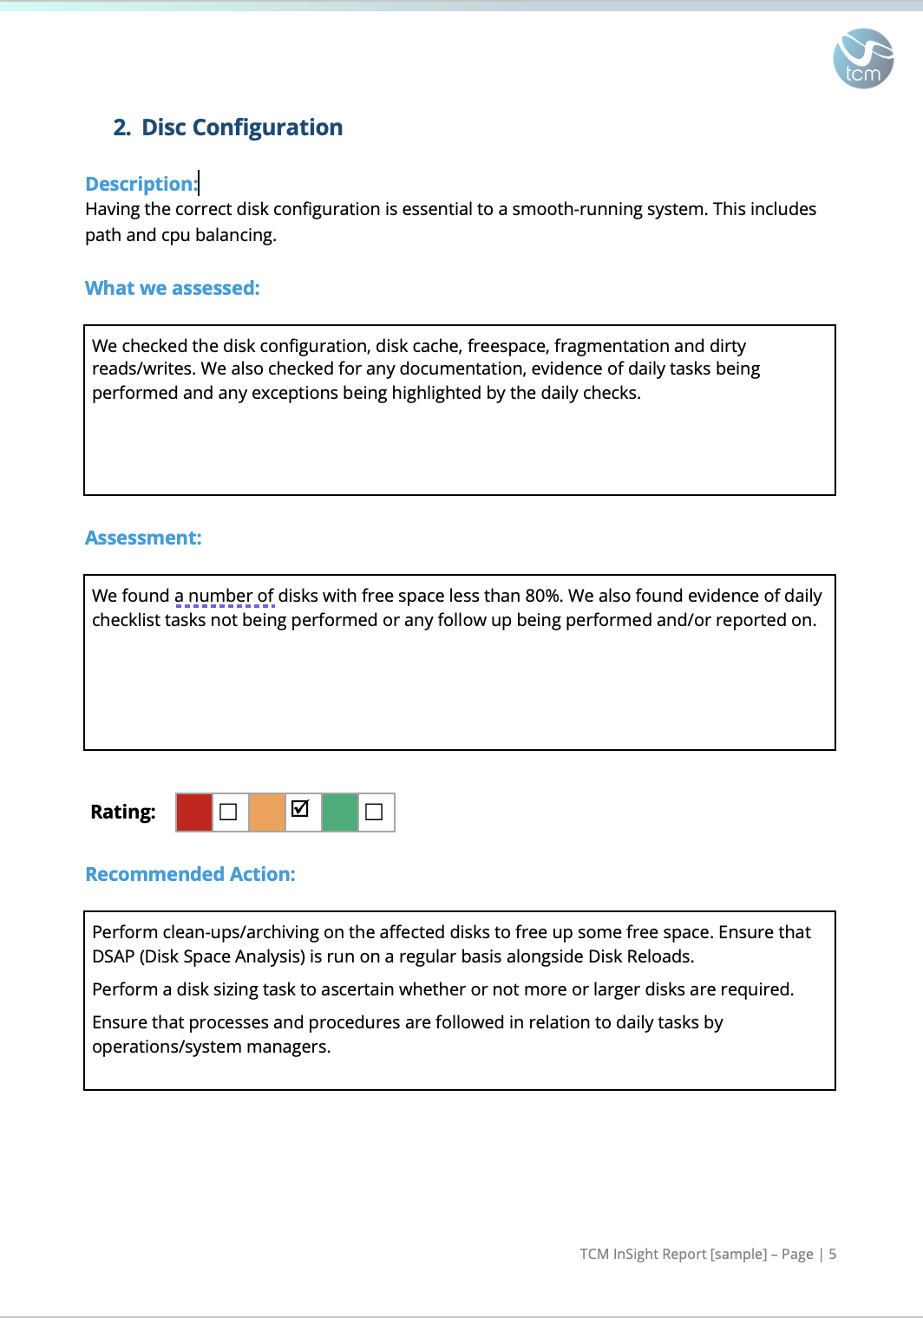
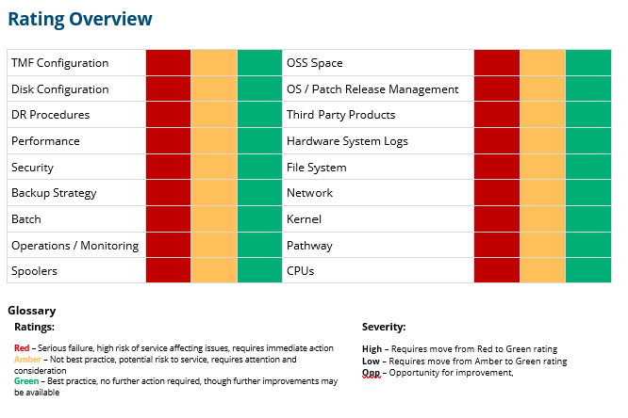
HOW IT WORKS
Report, Rate, Recommend, Review
  TCM will produce a comprehensive report providing an assessment of 18 NonStop areas of interest
  Each area will be scored using a simple traffic-light rating system providing ‘at a glance’ understanding
  Findings and further recommendations will be provided, identifying the path to Best Practice
  A follow-up review with the Customer will explore the report and provide an opportunity to discuss any findings or ratings in greater detail
HOW IT WORKS
Confidential. Copyright TCM Solutions Ltd 2023.
www.tcm.co.uk
+44 (0)1592 770081

Slide 24




HOW IT WORKS
Recommended Actions:
  No further action
  Recommend change to process / configuration / setting
  Recommend new product / tool / service
  Recommend further, deeper analysis of certain area(s)
HOW IT WORKS
Confidential. Copyright TCM Solutions Ltd 2023.
www.tcm.co.uk
+44 (0)1592 770081

Slide 25


Benefits
Inexpensive
Efficient use of time – results within one week
Despite efficiency – still comprehensive
Independent, objective analysis (not a witch hunt)
Confidential. Copyright TCM Solutions Ltd 2023.
www.tcm.co.uk
+44 (0)1592 770081
Does not require NonStop knowledge to understand report
Minimally invasive – touch of a button
One-off / annually / periodically
Tailored and scalable

Slide 26


WHY GET InSight?
Systems Managers:
Personal development / continuous improvement – same reason we attend Connect NSTBC!
Confirmation of competence
Justification for recommended system improvements, training etc.
Confidential. Copyright TCM Solutions Ltd 2023.
www.tcm.co.uk
+44 (0)1592 770081
Senior Management, looking for independent appraisal of NonStop function:
Recently assumed responsibility for technology
Changes in team / support function
Wider organisational continuous improvement / compliance programs
This Photo by Unknown Author is licensed under CC BY

Slide 27

HOW TO GET
InSight
For more information about InSight, or any of our NonStop services, speak to TCM today or reach out to your HPE NonStop Account Manager
nonstop@tcm.co.uk
Confidential. Copyright TCM Solutions Ltd 2023.
www.tcm.co.uk
+44 (0)1592 770081

Slide 28

Thank You
www.tcm.co.uk

Slide 29
TCM – The NonStop Experts
www.tcm.co.uk

